Slide 1
Advocacy 101: Become an Advocate for Kids
Laura Knudtson – Parent Possible
Jennifer Spires – Save the Children Action Network

Slide 2
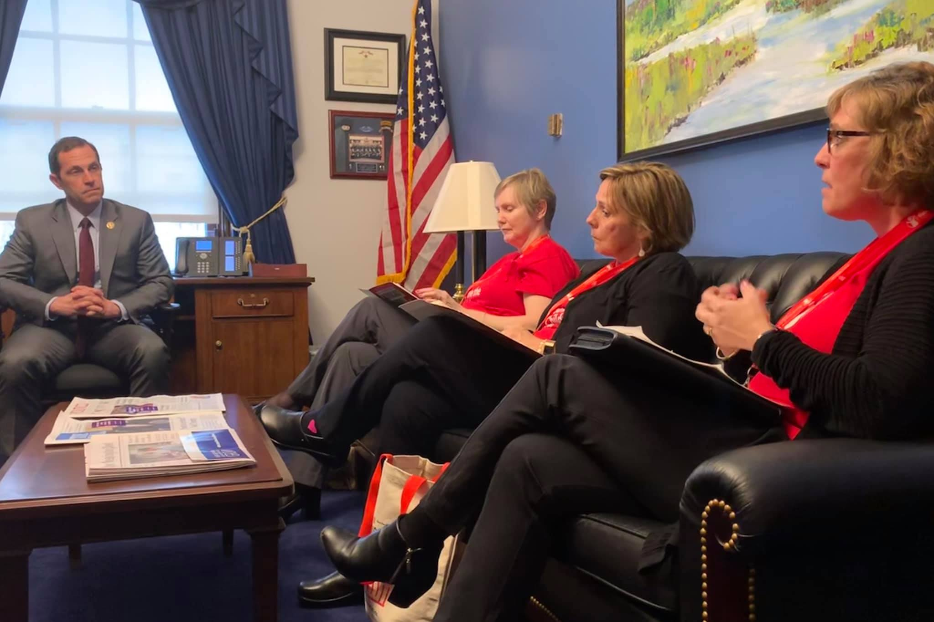
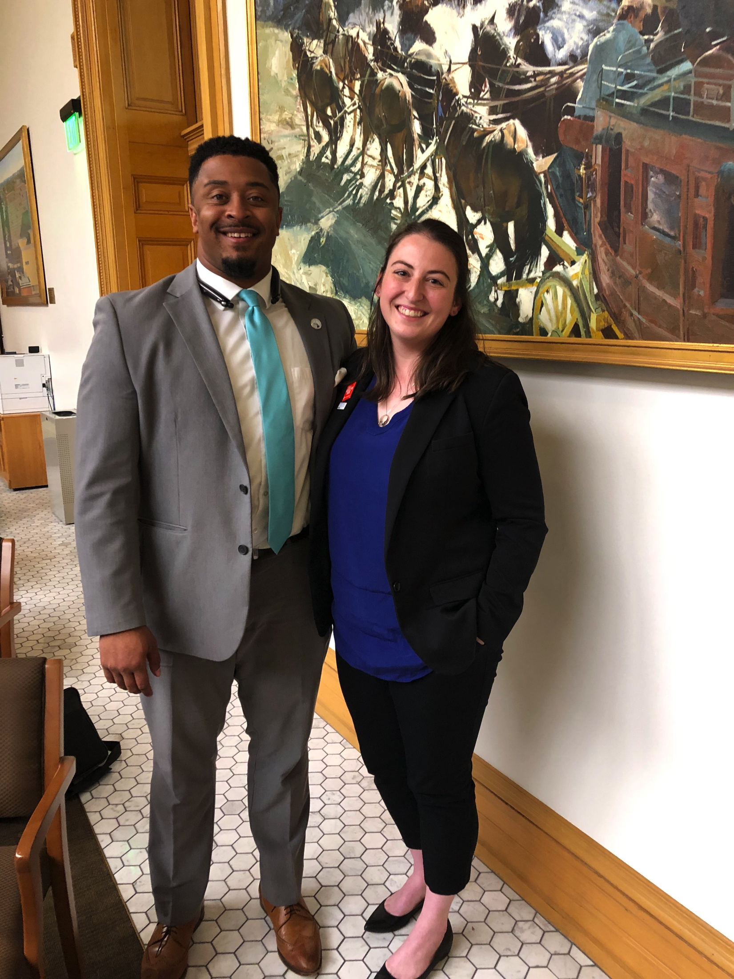
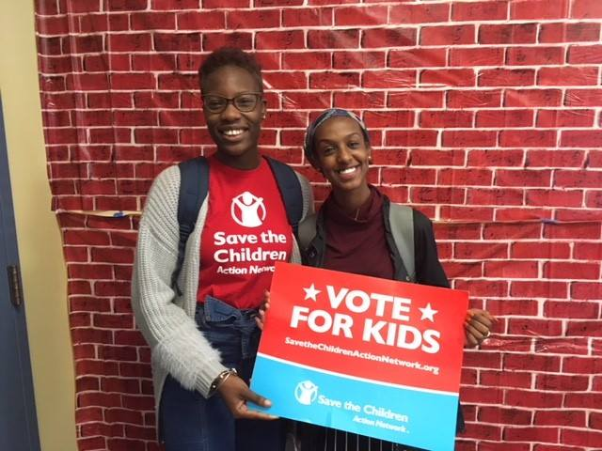
Save the Children Action Network (SCAN)
Advocate on early childhood issues at the state, federal, and international level
Work alongside other advocacy groups including Full Day Kindergarten NOW!
Organize community events
Empower volunteers to advocate
Notes:
SCAN Priorities
-Colorado: Full Day K, expand quality early learning
-National: Decrease child care deserts (Child Care Workforce and Facilities Act); 51% of Coloradans in child care desert
-International: Protect children and schools in conflict zones
SAVE also runs Head Start programs and Early Steps to School Success (home visiting, book exchanges, parenting groups, transition to school)

Slide 3
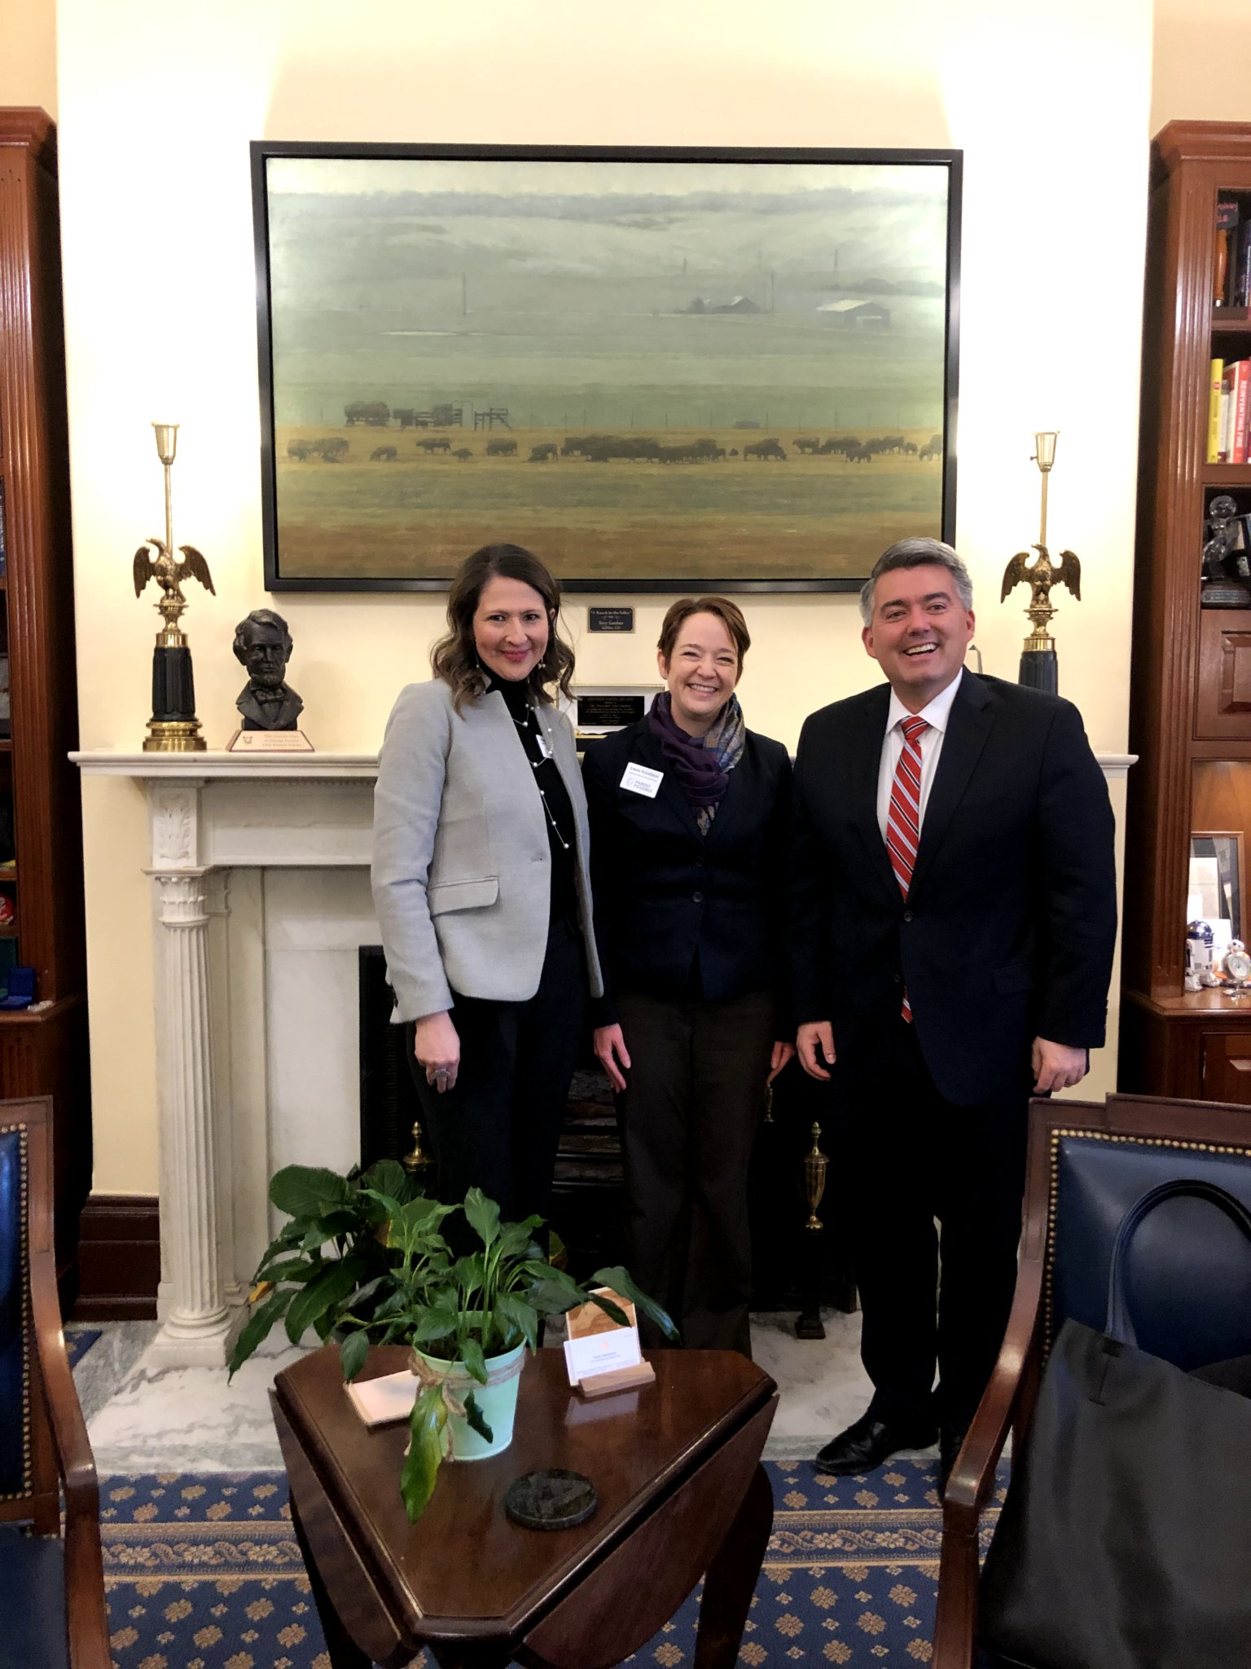
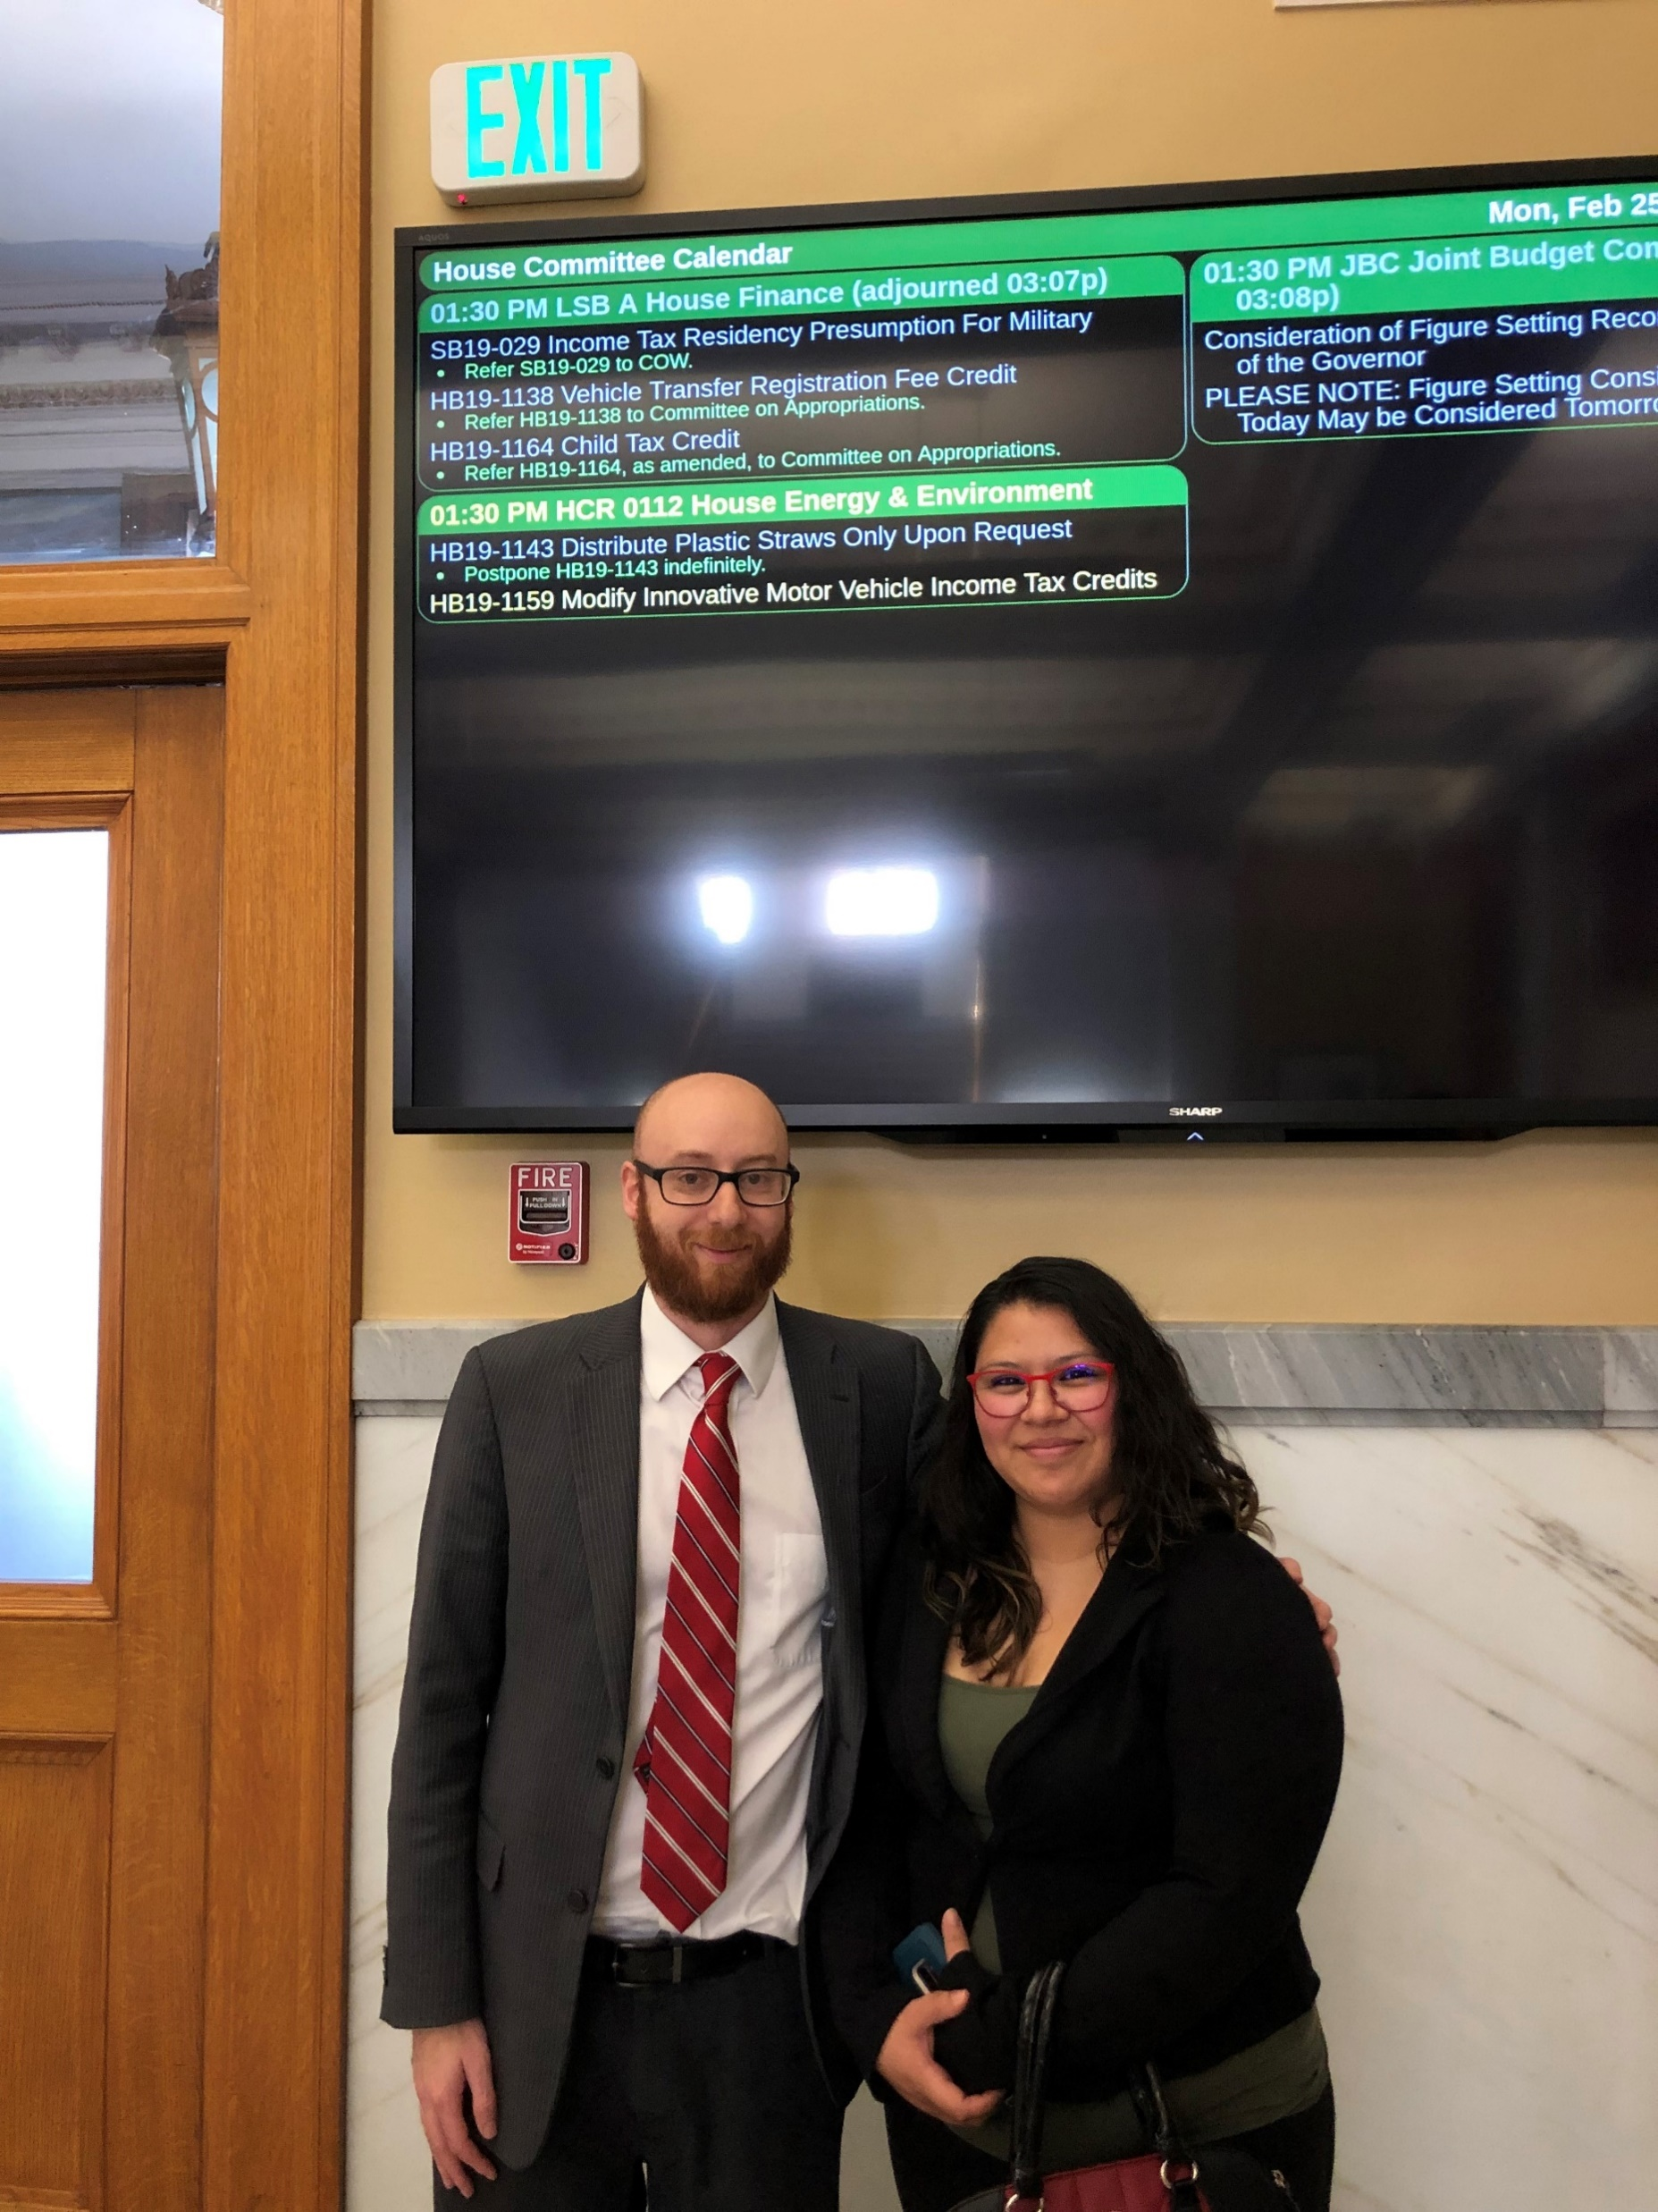
Parent Possible Advocacy Work
Chair the Colorado Home Visiting Coalition
Advocate for state and federal policies that support families with young children
Coordinate with other advocacy groups in Colorado
Develop and summarize data to support our positions
Notes:
Director of Community and Government Relations at Parent Possible. We currently chair the CHVC which is a coalition made up of many of the home visiting models in Colorado like PAT, HIPPY, NFP and SafeCare that collaborate to strengthen and advance effective home visiting services across Colorado. In doing this work we advocate for policies at the federal and state level that will support families from the pregnancy phase through early childhood – particularly for families with fewer resources. We are actively involved with work with other early childhood advocacy partners and are on the steering committee for Raise Colorado that focuses on advocating for pregnant people and families through age 2 through an equity lens. Finally, we are actively engaged in data gathering, research and presentations to support our advocacy positions.

Slide 4
Why is advocacy important?
Kids can’t vote
Find your passion
Tools to be a better advocate
Find your legislators!
State:
leg.colorado.gov/findmylegislator
Federal:
www.govtrack.us/congress/members
Notes:
Priorities and Importance of Advocacy in General
-kids can’t vote: be a megaphone for their voices
-find your passion: number of EC issues to advocate for (home visiting, child care, elementary education, social services, health and wellness, post natal parental wellness, etc)
-there are tools to help you become a better advocate: trainings, books, websites
-find your legislator: leg.colorado.gov/findmylegislator
- Take out your device to search for your legislators right now.

Slide 5
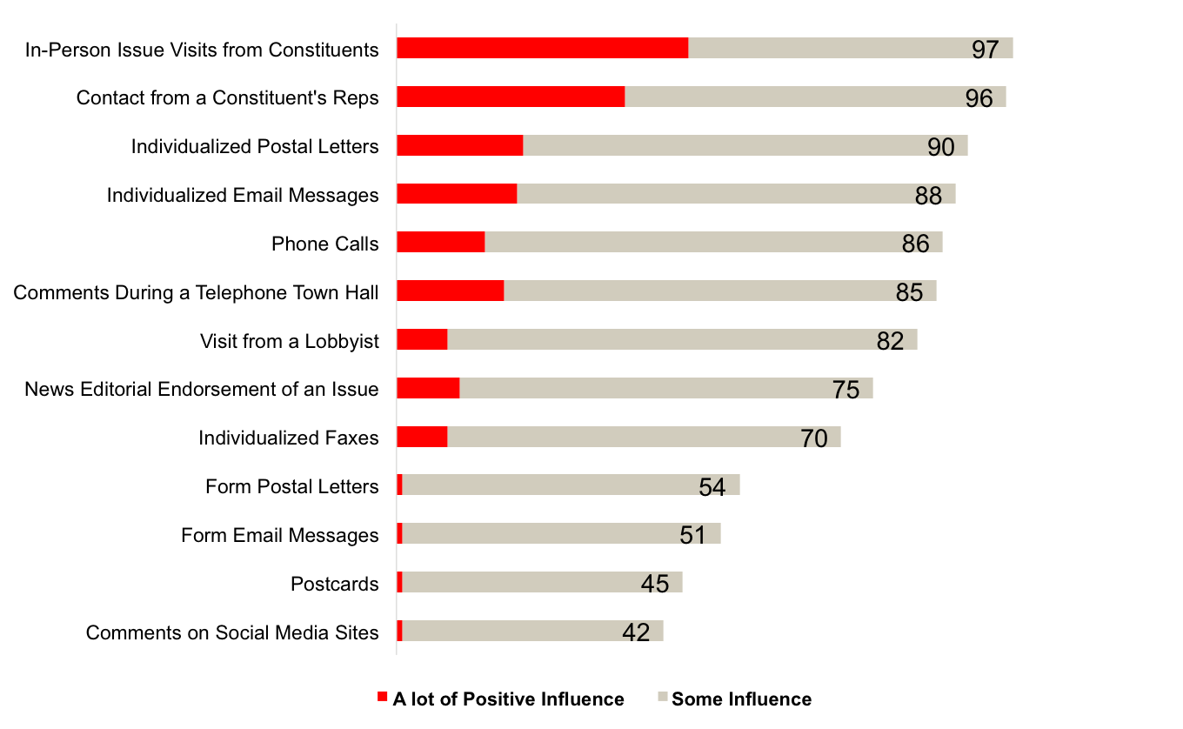
Why is advocacy important?
Notes:
15 minutes – up through this point (1045-1100)
IN 2015 the Congressional Management Foundation did a survey of staff who work on Capitol Hill for our Members of Congress.
Here is what they found (review)….BUT we know that a combination of all outreach is the best approach. There is a common ingredient in all of these, however, and it is really the foundation of all “messaging” to lawmakers, be that a call, a letter, an opinion piece, or an in person visit.
MOST EFFECTIVE IS SPEAKING DIRECTLY WITH A HUMAN BEING
-But how do I do that?

Slide 6
Why are you here? Telling your story
Each of us has a compelling story to tell.
What will I be calling on others to do?
What stories from my life show a need for action?
What moved me to action and what might inspire others?
Notes:
10 minutes (1100-1110)
Each of us has a compelling story: What made you choose this session? What experiences shaped your life?
Your story should be shaped by three things:
-connection to purpose/ask (what will I be calling on others to do)
-real world experience (what stories show a need for action)
-driving force (what moves me/inspires others)
Examples:
-SCAN Advocacy Day on the Hill
-Personal story
Take time to think about and write down a personal story of your own (5 minutes)

Slide 7
Creating an Elevator Pitch
Short
Personal – Why do you care?
Urgency – Why should someone care now?
Ask – How can this person help?
Notes:
10 minutes (1110-1120)
Elevator Pitch!!!! What is an elevator pitch and why do we call it that?
Ask audience. Exactly. Short, personal and urgent.
We process one story better than we do statistics and numbers.
Kimberly tells story about Marco Rubio.
Let’s do an example of a pitch together. Annalise tries to Pitch Kimberly or (volunteer Annalise chooses beforehand) on Reach with post card in hand. Kimberly or volunteer is on her phone sending text messages. How did I do? Ask Audience.
Let’s watch a short video about designing an elevator pitch. Let’s watch a video that walks us through a strong elevator pitch”
https://www.youtube.com/watch?v=7DAch1BNhYc

Slide 8
Exercise: Developing your pitch
Pair up with someone you don’t know
Practice your pitch with that person
Why do you care?
Why is the issue urgent?
What can the person do?
Notes:
10 minutes (1120-1130) Each have 5 minutes in pairs

Slide 9
Elevator Pitch Debrief
Reactions
What worked?
What did not work?
What would you do differently?
Notes:
5 minutes – 1130-1135
Practice, practice practice
No unnecessary details
One story/one issue
Don't overload them with facts
Leave time for questions/make it a conversation
Center around the personal

Slide 10
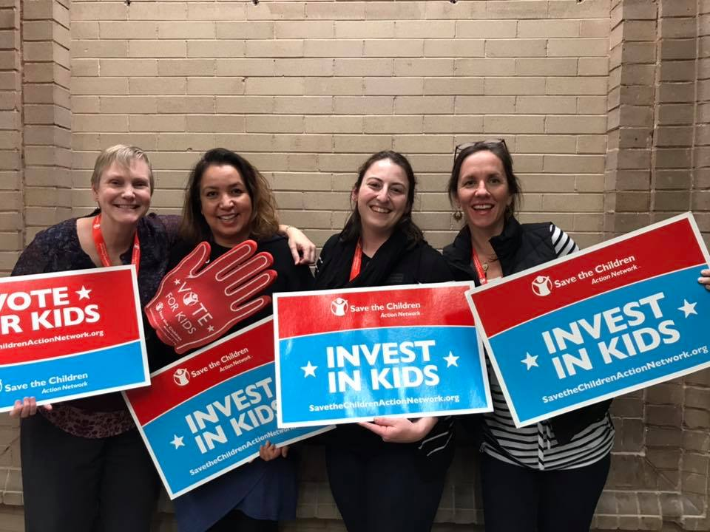
Take Action Now!
“Never doubt that a small group of thoughtful, committed citizens can change the world. Indeed, it is the only thing that ever has.”
-Margaret Mead
Notes:
1135-1140 (5 minutes)
-Postcards
-Sign up for SCAN email list/to volunteer
-offer other printed resources

