Slide 1
Beyond the First Year: Exploring the Impact Postpartum Depression Has on Families
Naomi Segel, MSW
nsegel@bouldercounty.org
Notes:
By a show of hands, who here knows someone who has experienced postpartum depression or has experienced it themselves?
As you can see, this is a lot of hands!
For as common as it is, postpartum depression beyond the first year is rarely talked about. Do people think that it just disappears? No! It absolutely can linger and have effecs on the mom, child and entire family. Today I am going to talk about this and share my story with you all.

Slide 2
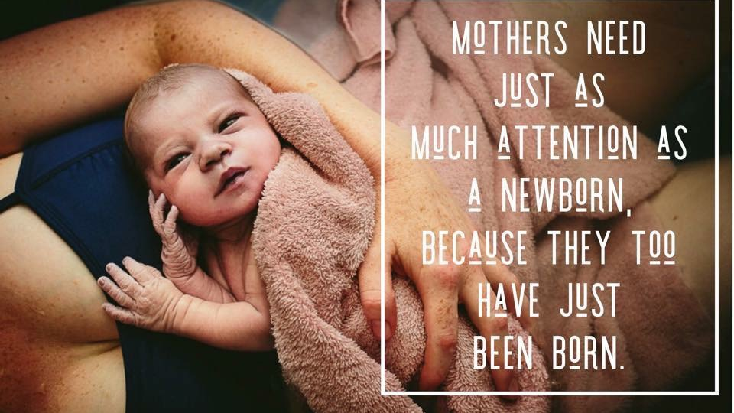
Notes:
Charlotte Watson

Slide 3
Take care of yourself!
If you need to leave the room, please do so!
There is a team here to support us all
Everyone’s experience with PPD is different
Notes:
Please notice if you are feeling sad, heightened or activated from this presentation. And that these feelings may linger after the presentation.
I will be focusing this presentation of moms however 1-10 dads experience postpartum depression

Slide 4
My story
“I watch as my family and friends dote over her and it pains me. I feel like a horrible mother for not loving her the way everyone else did.”
Notes:
This topic is really near and dear to me because (as I mentioned) I battled postpartum depression.

Slide 5
Postpartum depression
80% of mothers will experience “baby blues” within the first 2-3 days after delivery.
Mood swings, crying spells, anxiety and difficulty sleeping.
May last for up to two weeks.
15-20% develop PPD, anxiety, OCD or other mental health conditions.
For 1/2 of women diagnosed with PPD, this is their first episode of depression.
Notes:
Baby blues goes away on its own

Slide 6
What is postpartum depression?
Depression suffered by a mother following childbirth, typically arising from the combination of hormonal changes, psychological adjustment to motherhood, and fatigue.
Can occur anytime within the first 12 months after giving birth.
Untreated, postpartum depression may last for many months or longer.
Signs and symptoms of PPD vary and can range from mild to severe.
Notes:
PPD can make it hard for you to get through the day, and it can affect your ability to take care of your baby, or yourself.
PPD can affect any woman—women with easy pregnancies or problem pregnancies, first-time mothers and mothers with one or more children, women who are married and women who are not, and regardless of income, age, race or ethnicity, culture or education.”

Slide 7
Signs and symptoms
Depressed mood or severe mood swings
Excessive crying
Difficulty bonding with your baby
Withdrawing from family and friends
Loss of appetite or eating much more than usual
Inability to sleep (insomnia) or sleeping too much
Overwhelming fatigue or loss of energy
Reduced interest and pleasure in activities you used to enjoy
Intense irritability and anger
Fear that you're not a good mother
Hopelessness
Feelings of worthlessness, shame, guilt or inadequacy
Diminished ability to think clearly, concentrate or make decisions
Restlessness
Severe anxiety and panic attacks
Thoughts of harming yourself or your baby
Recurrent thoughts of death or suicide
Notes:
See handout for reference
It is important to note that mothers do not need to have all of these symptoms to be depressed

Slide 8
Risk factors
Previous experience of depression or anxiety
Family history of depression or mental illness
Stress involved in caring for a newborn and managing new life changes
Having a challenging baby who cries more than usual, is hard to comfort, or whose sleep and hunger needs are irregular and hard to predict
Having a baby with special needs (premature birth, medical complications, illness)
First-time motherhood, very young motherhood, or older motherhood
Other emotional stressors, such as the death of a loved one or family problems
Financial or employment problems
Isolation and lack of social support
Notes:
As you heard in my story, I had a difficult time bonding with my baby, I was irritable all the time, I had difficulty sleeping, and severe anxiety.
I experienced the emotional stressor of having a miscarriage without getting support before getting pregnant with my daughter. I had difficulty bonding with my baby in utero for the fear I might lose her.
After she was born, I was affected by hormonal changes, fatigue and lifestyle changes.

Slide 9
Causes
The cause is unknown
Sharp drops in estrogen/progesterone and thyroid hormones at post-birth
Link between miscarriage, PPD, and PMS
Stress
Sleep deprivation
Nutrition deficits
Notes:
During pregnancy, estrogen and progesterone levels increase, only to rapidly return to normal within 24 hours of childbirth. It is this rapid change in hormone levels that is thought to be related to postpartum depression

Slide 10
40% of PPD cases go undiagnosed and the women do not get appropriate help.
Most reports do not include PPD that occurs after stillbirths or miscarriages.
PPD is more common than we can account.
Many mothers suffer silently.
Notes:
A significant number of the cases go unreported and are not included in national and global statistics.

Slide 11
What I noticed…
I had no connection with my baby
I felt nothing
I avoided my baby
I had severe anxiety and sleep issues
I started to panic when it was getting close to nighttime
I had a short temper, impatient
Easily frustrated
I avoided people at work
I did not like my baby
I could not enjoy the present moment.
I kept waiting for it to “get better” or “get easier.”
Notes:
I preferred housework, laundry, cleaning, organizing diapers/nursery, etc.
When people came over to visit I would immediately hand them my baby
I had trouble falling asleep or staying asleep because I knew the baby would wake soon and need to nurse
Easily frustrated would snap at my husband
Even when I sought help, the first therapist I met with made me feel even worse.
A therapist asked me, “but of course you love your baby don’t you?” Actually no, at the time I did not love my baby.
As home visitors, it is important to be careful with the language you use. Don’t ever make assumptions!!
Do not assume that a mom is excited to be pregnant or this it’s “the most amazing time in her life” being a mom

Slide 12
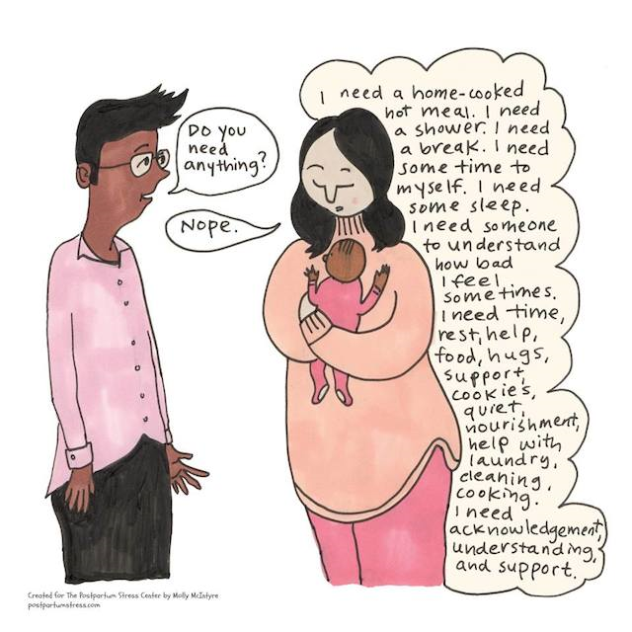
Why is this important?
Notes:
Take a moment to look at this illustration
Because PPD affects babies, moms and the entire family system

Slide 13
How PPD affects babies
https://www.youtube.com/watch?v=Ay41gm0UVQ0
Published on May 10, 2016
Postpartum Support International:
Call 1-800-944-4773 (4PPD) (English and Spanish)
Text 503-894-9453
National Suicide Prevention Lifeline
1-800-273-TALK
Notes:
This is a short video from the University of Calgary professor Nicole Letourneau who will discusses how postpartum depression affects babies development

Slide 14
Notes:
Ainsworth and Bowlby theories
Attachment: refers to the emotional connection that babies form with their caregivers. Attachments are built on shared experiences over time that contribute to a sense of trust and connection.
Healthy/Secure attachment: supports a baby’s social and emotional development throughout his or her life. Healthy attachments develop when a mom (or other primary care taker) is able to respond to a baby’s cues in a dependable way.

Slide 15
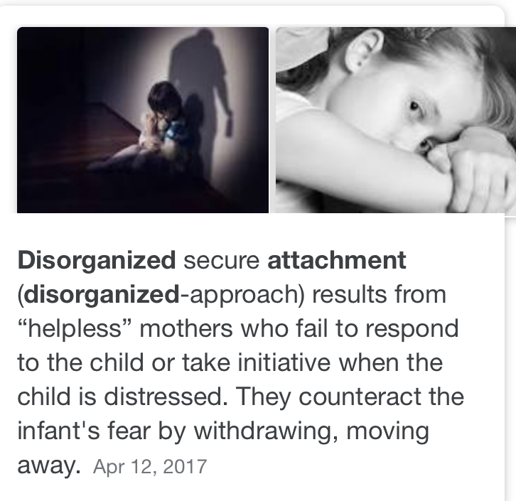

Slide 16
Attachment at an early age (0-5) and its impact on children’s development
Differences in attachment are not genetically determined but are rooted in interactions with the social environment during the first few years of life.
Sensitive or insensitive parenting plays a key role in the development of secure or insecure attachments.
Source: Marinus van Ijzendoorn, PhD
Leiden University, Netherlands (March 2007, 2nd ed.)
Notes:
This means that parents have such a direct influence. It’s all about the relationship that parents have with their child. This is why PPD can have such an effect on attachment.

Slide 17
Bonding with baby: attachment and the PPD mom
For an attachment to be strong, a mom does not need to be with her baby all of the time
Mistakes are an important part of healthy attachments
There will be plenty of disappointment in healthy attachments
Responding appropriately to your baby’s needs does not always mean that you will respond immediately
https://postpartumprogress.com/bondi
Kate Kripke, LCSW
Notes:
Almost every mom who struggles with a mood and anxiety disorder like PPD worries about attachment.
1.) Quality not quantity
2.) Strong bonds are those that occur when mistakes are made and then repair of those mistakes follows.
3.) There is plenty of disappointment in healthy attachments. For example, having the partner put the baby to bed so that mom can get out to see a friend or take a break, keeping a baby is in childcare so that mom can work or take time for herself.
4.) what matters is that your child feels that his or her need is being seen and recognized
Can I let my baby know that I hear him/her when there is a need that I can’t respond to right away?
Can I spend at least one, short, specific period of time each day looking into my baby’s eyes, playing, and encouraging laughter?
Can I bring in support when I notice that my baby has a need that I cannot meet?
What do I need to do to take care of myself so that I can be as present and consistent with my baby as possible?

Slide 18
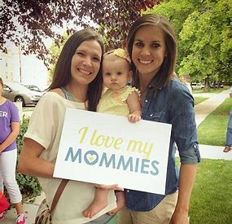
How long does PPD last?
It is unknown the exact amount of time it takes to recover from PPD.
It’s different for everyone (true for all depression)
Source: Katherine Stone, Postpartum Progress

Slide 19
How long does PPD last?
There are many different variables affecting how long it takes each person to get better:
How long did you suffer from PPD before you reached out for treatment?
How severe is your postpartum mental illness?
How effective is the postpartum depression or postpartum anxiety treatment you have been using?
How effective is the postpartum depression specialist you are working with?
What is your current life situation and how may it be affecting your recovery from postpartum depression?
What have you been doing to follow your postpartum depression treatment plan and take care of yourself?

Slide 20
What the research says
Clinical studies show:
Symptoms of postpartum depression in most women recede over time, but for a large number of women, depression remains a long-term problem.
38% of women with postpartum depression experienced chronic symptoms.
In women who were receiving medical care, 50% of patients experienced depression for more than 1 year after childbirth.
30% of women with PPD who were not receiving clinical treatment were still depressed up to 3 years after giving birth.
Source: How long does postpartum depression last? By David McNamee https://www.medicalnewstoday.com/articles/271217.php
Notes:
Harvard Review of Psychiatry, researchers compared the findings of studies on postpartum depression published between 1985 and 2012. They wanted to see what limitations the existing studies into postpartum depression may have, and what implications this has had for women with postpartum depression and their children.
This was an AH-HA moment for me! It made me realize that I was not alone nor crazy that my symptoms did not disappear after 1 year.

Slide 21
Research
The research team also acknowledged that more educated management of the condition should limit the adverse effects on child development, saying that:
"Because postpartum depression (PPD) has significant consequences for the baby, for the depressed mother, and for the early relationship between mother and child, knowledge about prolonged changes in the mental health of mothers with PPD may not only improve our understanding of the course of PPD, but also inform prevention and intervention strategies.“
Notes:
This is why this topic is so important and needs to be talked about more. We need to be managing this in a more educated and wholistic way that support the mother and baby to mitigate negative effects on attachment and child development- which I will talk about more on the next slide

Slide 22
PPD and long term effects on children
Increase the risk of adverse outcomes in children.
Can cause delays in cognitive and language development, disorganized or insecure attachment, higher rates of behavioral problems, and lower grades.
Can even cause higher rates of depression in children during the teen years (16 to 18 years old).
Source: Netsi E, Pearson RM, Murray L, Cooper P, Craske MG, Stein A. Association of persistent and severe postnatal depression with child outcomes. JAMA Psychiatry. 2018;75(3):247-253. doi: 10.1001/jamapsychiatry.2017.4363.

Slide 23
What home visitors may notice on visits
Increased anger/frustration toward a specific child
Attachment issues
Avoidance
Mood swings
Feelings of guilt and resentment
Navigating conflicting emotions
High scores on depression screenings
Notes:
Example: there is a PAT family in our program who recently experienced PPD with her 3rd child (who did not have PPD with her previous children). The home visitor noticed the following:
-Being irritable with that child while with the other 2 children she had more patience
-Noticing physical affection with 2 older children but pushing away this child
-Mom left this child with the godmother for extended periods of time
-After talking with mom further, she disclosed that she did not want a 3rd baby. Her relationship with her partner was in a difficult space. She did not bond with the baby in utero or as a newborn.

Slide 24
Gratitude activity
Notes:
For some moms struggling with postpartum depression, it can be helpful for them to think about things they are grateful for and to help them realize that they still have a life and greater purpose than their baby.
This is an activity that can be used with PAT families

Slide 25
How to heal from PPD
Psychotherapy
Antidepressants
Zulresso- new rapidly acting drug for PPD
Natural progesterone
Exercise
Support groups
Relationship with nature
Meditation/spirituality
Notes:
How to heal is going to look different for everyone. Regardless, it takes time to heal
Zulresso is a new fast acting drug that provides relief in 48 hrs, must be hospitalized and administered by an IV. Very expensive and unclear if insurance will cover the cost. Coming out this summer.

Slide 26
What helped me
Make sleep a priority
Limit social media
Stop comparisons
Self-care
Spend time away from your child/children
Daycare/support
Say NO and set boundaries
Spend 1-1 time with each child
Notes:
We talk about sleep routines with children, I have a very specific sleep routine. Taking melatonin, essential oils and chamomile tea. No screen time 1 hour before bed
Stop reading mom blogs! Stop comparing yourself to “the perfect family.”
Self care for you and your spouse

Slide 27
What helped me
Forgiveness
Gratitude
Stop negative self talk (using affirmations)
Therapy (individual and couples)
Writing
Making big and small changes
Relationships with each child is different and that is OK
Looking at struggles as opportunities to grow
Notes:
Writing and spending time alone to process
Big and small changes: looking up instead of down (notice the sky, the mountains). Driving a different way to a home visit
I moved to a new house (fresh start) and I started a new job (putting family first)

Slide 28
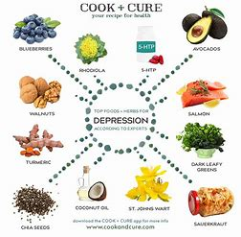
Diet
Foods that help battle depression:
Eat omega-3 fatty acids
Fish/fish oil, nuts and seeds, avocados, flaxseed oil, and walnuts
Cut out sugary drinks. Instead, drink water!
Limit alcohol intake
Limit processed foods
Notes:
Some studies show lower overall rates of depression in countries where people eat large amounts of fish. Fish oil supplements.
Eating small amounts of protein throughout the day helps keep blood sugar levels even and moods stable. Eating dairy products, poultry, meat, and fish – along with low-glycemic carbs like nuts, whole grains, and beans – can boost production of serotonin, a neurotransmitter which has a calming effect on the brain.

Slide 29
Strategies that would have helped me heal sooner
Having a home visitor
Having the right therapist
Having a bedtime routine for myself
Natural estrogen
Better screening and follow through during pre/postnatal appointments
Knowing about this ahead of time
Notes:
Birth preparation classed need to talk about this! Not just mention that you need help if you want to harm yourself or you baby. That there is a varying spectrum of PPD and it can look different for everyone

Slide 30
Notes:
Self-care reminders
See handout

Slide 31
Vision board

Slide 32
Mantras
Write Your Own Mantra:
“I am enough”
“I will be OK.”
“I can be healthy.”
“I am grateful for my life.”
“I believe in myself.”
“This is temporary. I am strong”
“I am breathing in, I am breathing out.”
“I am not afraid.”
“Say yes to new adventures.”
Notes:
A mantra is: a repeated word or phrase
It can be used to change negative thought and to help with motivation
An activity could be to create a few mantras for a mom to say to herself, post on a mirror, etc.
Hand out affirmation cards

Slide 33
Resources
Postpartum Progress
https://postpartumprogress.com/
Postpartum Support International
https://www.postpartum.net/
Mayo Clinic
American Psychological Association
Postpartum Wellness Center
Kate Kripke, LCSW

Slide 34
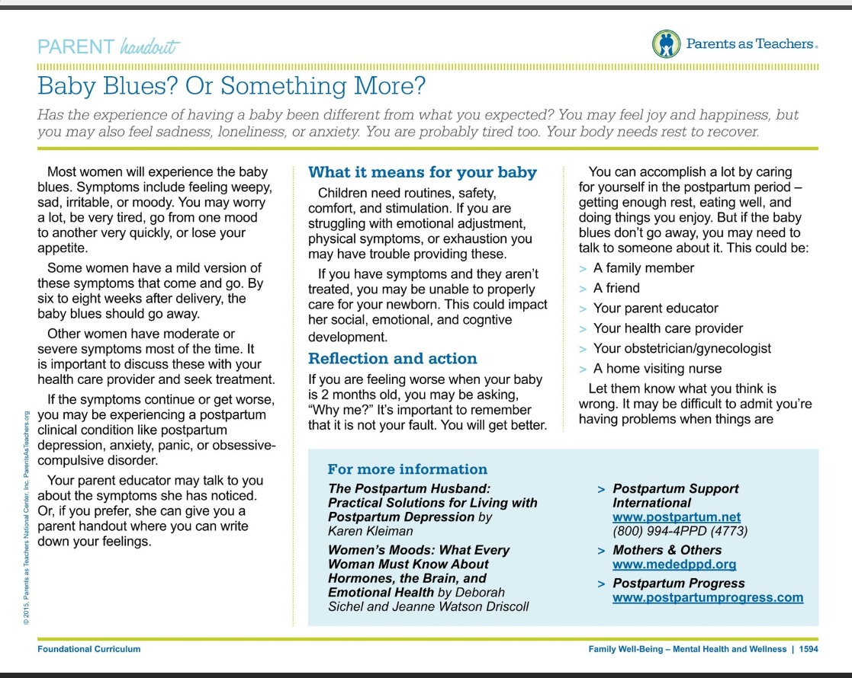
PAT curriculum
Notes:
As home visitors, info on PPD can be found in the curriculum
Postpartum Progress New Mom Checklist for Maternal Mental Health (English and Spanish)
Mom completes the lists and brings it back to a medical professional
We use the PHQ to measure depression- this is a broad assessment
There is also the Edinburgh Postnatal Depression Scale

Slide 35
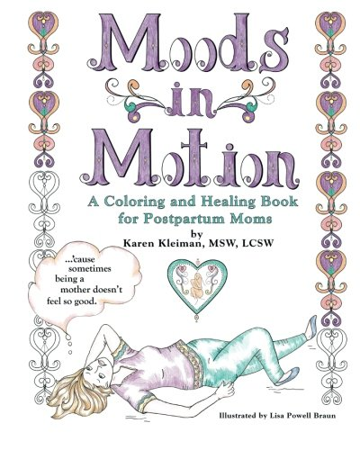
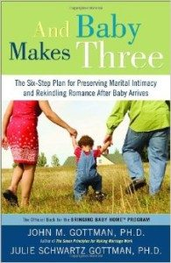
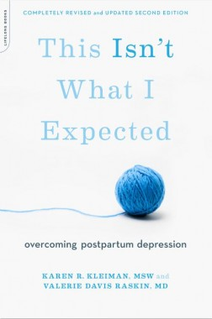
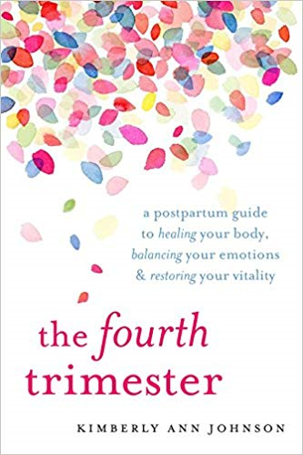

Slide 36
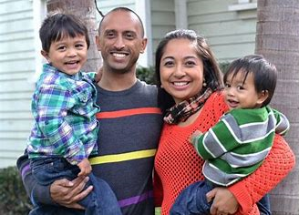
Thank you!
Notes:
I am going to end with reading a quote by Jess Marie
“Nothing makes me feel quite as overwhelmed at the words “enjoy every minute.” If I look back at myself, a brand new mama, I wouldn’t tell he to enjoy every minute. I’d tell her to just breath, it’s all going to turn out fine. I’d tell her she seemed like a fantastic Mom. I’d tell her it’s okay to be overwhelmed sometimes, and that we all are. I’d tell her not to listen to the voices that question her every move (whether internal or external). I’d tell her that motherhood is a constant state of becoming someone we didn’t use to be, and that transition can be hard as crap. I’d tell her it would be worth it and she was going to do great.

