Slide 1
Reflective Practice

Slide 2

Pick a Rock that Speaks to You

Slide 3

Share with a partner why this rock called to you

Slide 4
Reflective Practice
Reflective practice is the ability to reflect on one's actions so as to engage in a process of continuous learning.

Slide 5
Key Rationale
Reflective practice is that experience alone does not necessarily lead to learning; deliberate reflection on experience is essential.

Slide 6

Share an experience that was helped by reflection

Slide 7
The Advantages of Reflective Practice
bring together theory and practice
important source of personal professional development and improvement
A person who reflects throughout his or her practice is not just looking back on past actions and events, but is taking a conscious look at emotions, experiences, actions, and responses, and using that information to add to his or her existing knowledge base and reach a higher level of understanding.

Slide 8
Who Invented Reflective Practice
John Dewey- Educator 1859-1952
History and background
Donald Schön's 1983 book The Reflective Practitioner introduced concepts such as reflection-on-action and reflection-in-action
Kurt Lewin and Jean Piaget were developing relevant theories of human learning and development
Precursors of reflective practice in ancient texts such as Buddhist teachings

Slide 9
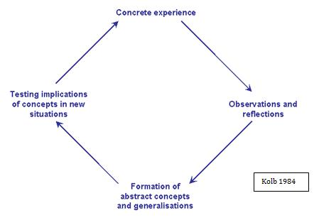
Kolbs Model of Experiential Learning

Slide 10
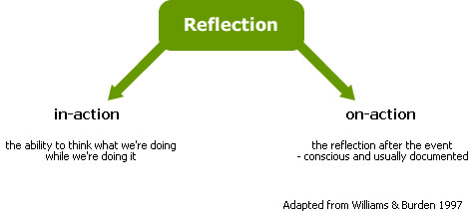
Donald Schön In Action…On Action

Slide 11
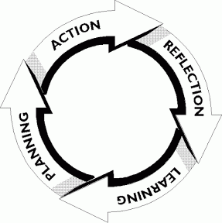
The Reflection Cycle

Slide 12

Story About the Home Visit that Describes the Reflection Cycle

Slide 13
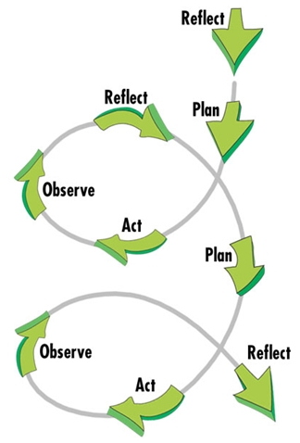
Experienced Utilization of Reflective Practice

Slide 14

Are you a person who goes to reflection easily or do you have to be encouraged?

Slide 15
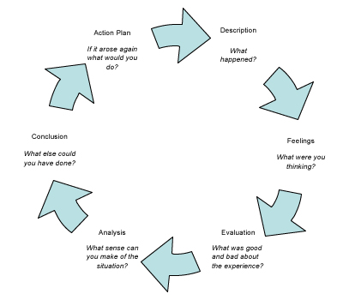
Connecting Feelings with Thinking

Slide 16

How Feeling can Cloud Service Delivery

Slide 17
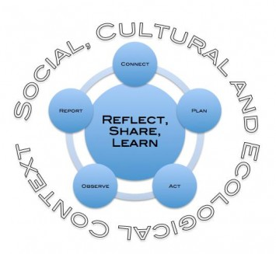
All within the context of your community

Slide 18

How context can effect service delivery

Slide 19
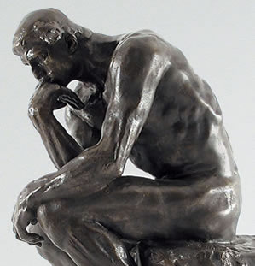
How to increase Personal Reflection
Ask open ended questions
Add Pauses
Wait for responses to questions
Add clarifying questions
Clarify understanding
When things don’t feel right or seem right ….seek to understand

Slide 20


Slide 21
How Could knowledge of Reflective Practice
Help increase positive outcomes in children and families?
Increase your ability to be an effective helper for the families your serve?
Increase your knowledge and skills in your current work?

Slide 22


