Slide 1
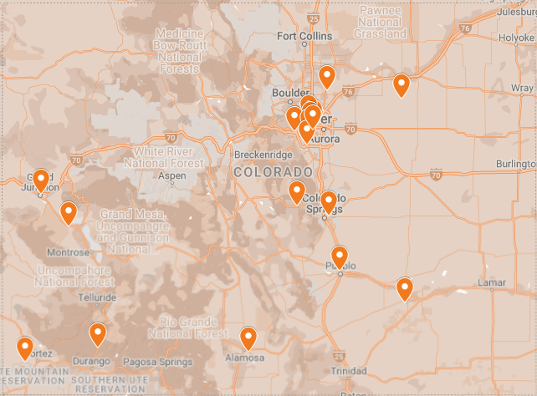
2023 ENHANCED HOME VISITING (EHV) PROGRESS REPORT
Parent Possible promotes and supports evidence-based, high-quality programs focused on parents of children from pregnancy through kindergarten.
Parent Possible serves as the lead agency for the Enhanced Home Visiting (EHV) Project, which aims to improve the social/emotional well-being and behavioral health of home visitors, site supervisors, families, and children. Between July 2022 and June 2023, EHV supported 20 community based organizations implementing the PAT or HIPPY home visiting programs across Colorado. Through EHV, over 130 home visitors and supervisors were offered regular reflective consultations, training, and mindfulness support.
EHV Sites Across Colorado
About this Report
In April 2023, 92 EHV participants completed a survey providing the data shown in this report.
Participant Demographics
Demographics are based on self-report survey responses collected annually from all participants.

Slide 2
Home Visitor Reflective Consultations
Licensed mental health consultants (MHCs) provide home visitors with individual and group-based reflective supervision sessions. The consultants help home visitors increase their ability to support social-emotional concerns, build and apply strategies to cope with secondary trauma, and build their professional self-confidence.
370
Sessions
(68 individual
and 302 group)
“Bottom line is that EHV has been very beneficial for every aspect of my life. Professionally, it's helped with burnout and the stressors we deal with at work. Personally, it's helped me to learn to take time for myself and give space for my children.” – Home visitor
Supervisor Reflective Consultation
A separate MHC provides individual and group-based reflective sessions with individuals who supervise home visitors to help them build their own reflective practice, increase their own self-awareness, and increase their confidence in their supervisory role.
66
Sessions
(56 group and 11 individual)
“If it hadn't been for programs like this, I'm not sure that some of my staff would still be here. Being able to support my home visitors through those times of working with those families is invaluable.”
– Supervisor
Professional Development Training for Teams
Over the past year, EHV sites participated in 4-hour trainings focused on providing education and strengthening attendees overall social-emotional wellness. These trainings addressed topics such as, “An Introduction to Trauma-Informed Care”, and "The Impact of Trauma on Early Attachment and Relationship Building”.
12
Trainings
Quarterly Mindfulness & Wellness Consultations
On a quarterly basis, each home visiting team also receives a two-hour virtual wellness consultation focused on secondary trauma and mindfulness. These sessions provide psychoeducation while focusing on skill-building activities for home visiting teams.
70
Sessions
“During these meetings, I started realizing that I never think about myself. Now I'm trying to find 10 minutes during the day to just reflect about how I feel. For me it's very beneficial.” – Home visitor
Parent Possible Conference
Each year, Parent Possible hosts a Conference that includes workshops on topics like Self Care and Resiliency, Trauma-Informed Leadership, and Motivational Interviewing as a self-care tool in working with trauma and to prevent burnout. These workshops are offered in both English and Spanish, and are open to participants in the EHV Project, along with those in other Parent Possible programs.
120
Attendees
(from the EHV project)
Notes:
Outputs

Slide 3
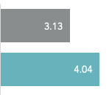
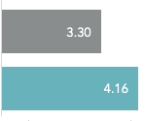
Team Support
Most home visitors rated the EHV project as “very helpful” in improving their effectiveness and helping them appreciate the importance of reflecting on their work.
Mindfulness
EHV uses the Cognitive and Affective Mindfulness Scale-Revised (CAMS-R) to explore changes in mindfulness. We saw that 82% of participants report higher levels of mindfulness after participating in EHV.
Self Awareness
On average, participants reported stronger self-awareness and reflective capacity, with end-of-year scores averaging over 4 on a 5-point scale.
Self-Awareness and Reflective Capacity
How well did/do you know your strengths and areas for growth?
How would you rate your ability to reflect on your work?
Before
Now
Notes:
Outcomes

Slide 4
Job Stress
Participants reported stronger abilities to navigate job stress as a result of this project. At the end of the year, 81% of participants rated themselves as strong or very strong at navigating job stress.
Ability to Navigate Job Stress
Weak
Neutral
Strong
Before
Now
Compassion Satisfaction
EHV uses the Professional Quality of Life Scale (ProQOL) to understand the satisfaction a participant gets from working in home visiting. We saw that 57% of participants report higher levels of compassion satisfaction, and an additional 23% reported no change but had the highest possible scores for this area.
“I feel like the skills that are taught within both the reflective supervision and with mindfulness consultations are invaluable. I've been able to use some of those things and bring it to my families as well, and they’ve been really appreciative… I truly think that more programs that are working with families should have reflective consultation.” – Home Visitor
Notes:
Outcomes

